Slide 1
Getting Real with VBA
Lesson 2.3

Slide 2
Words of Advice

Slide 3
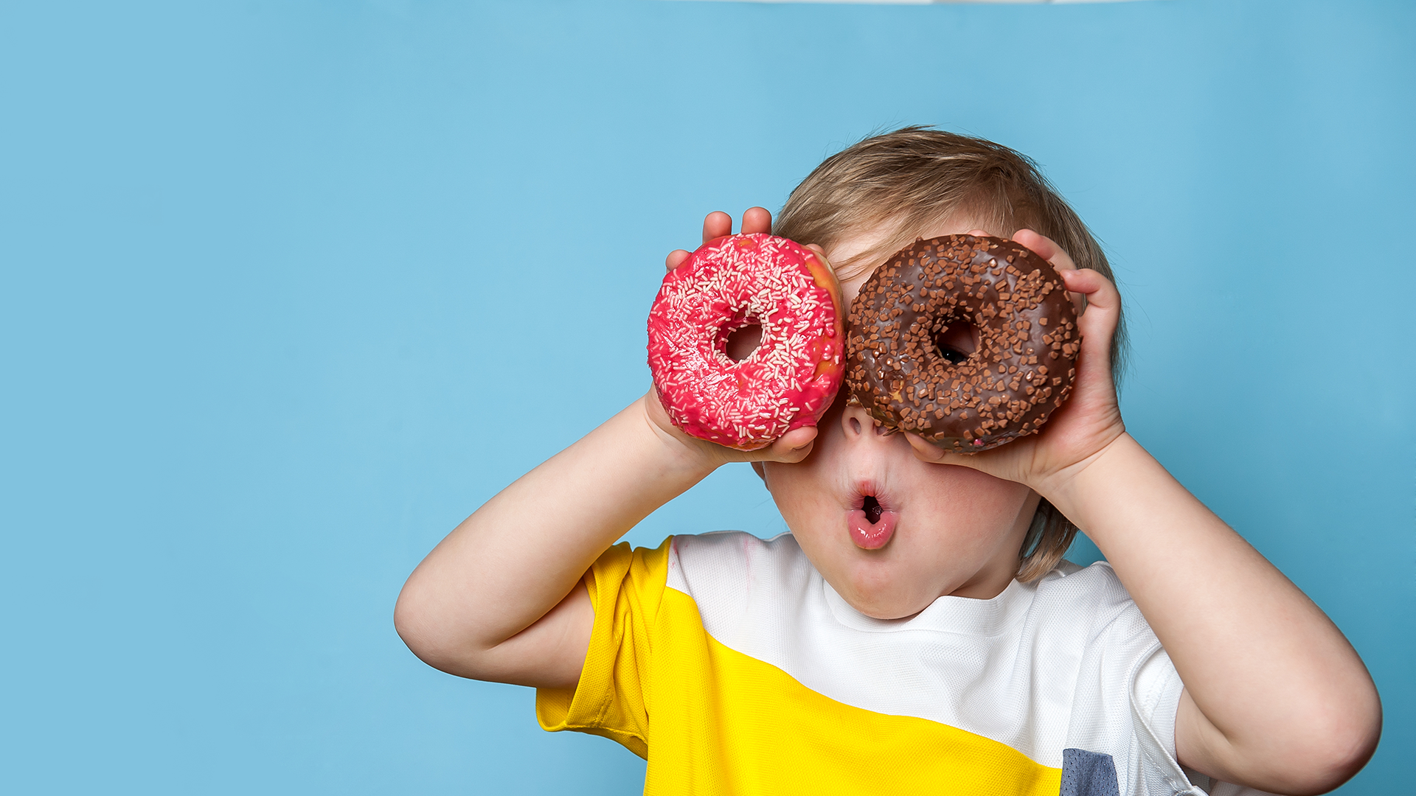
Advice #1
There is no cram.
Notes:
shutterstock_632097335

Slide 4

Advice #2
If you ever spend more than 10 hours on homework in a week without seeing progress, ask for help!
Notes:
shutterstock_483142393

Slide 5

Advice #3
Study the right way.
Notes:
shutterstock_1255208941

Slide 6
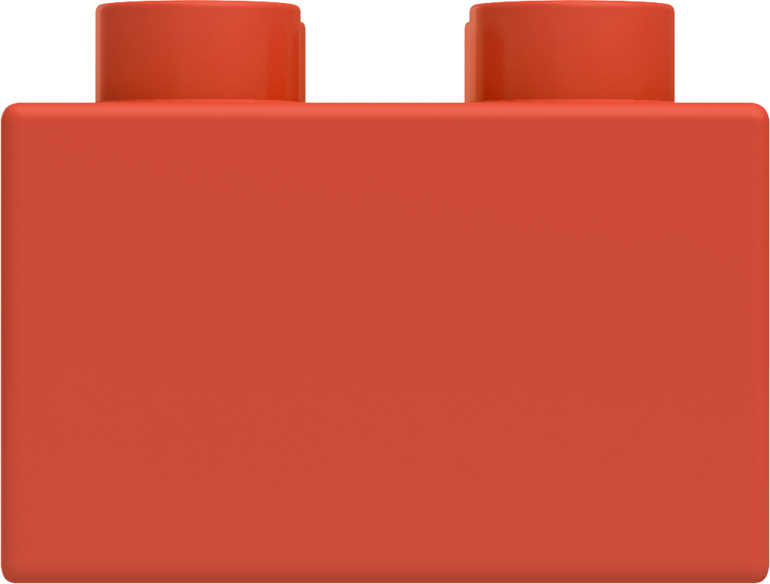



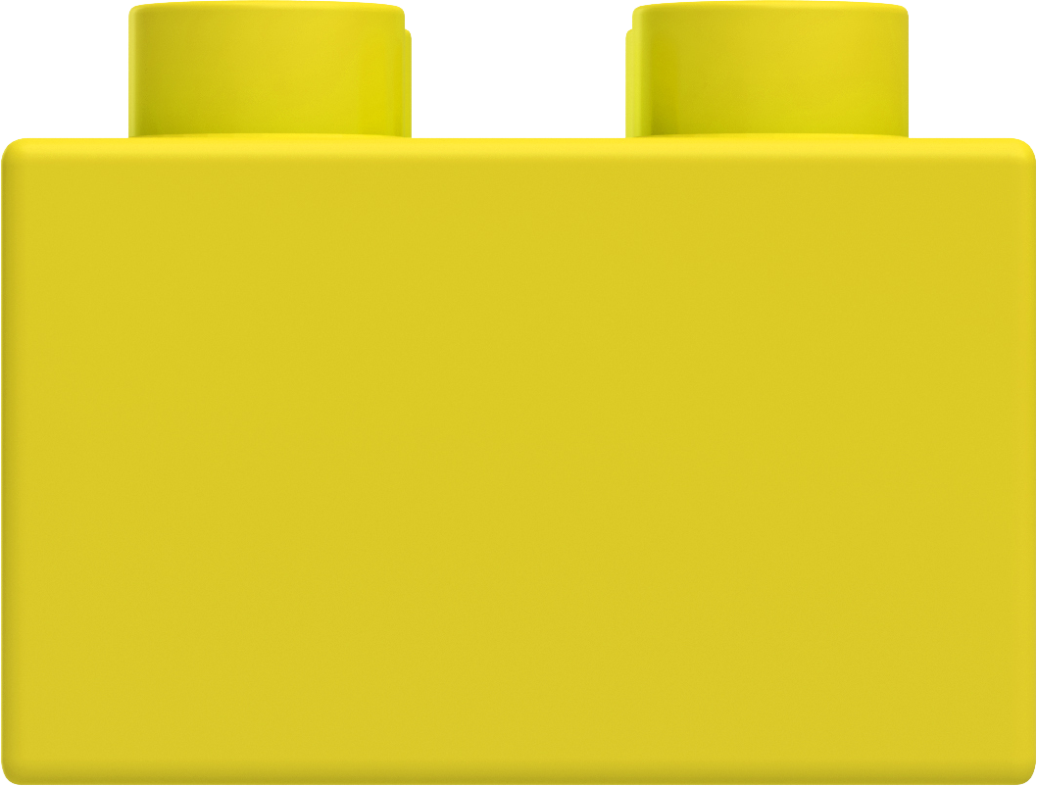


Study the Right Way
New Problem Solving
Code Organization
Documentation Research
Pattern Recognition
Pseudocoding
Debugging
CHALLENGE LEVEL
Technical Vocabulary
Syntax Recollection
Tool Familiarity

Slide 7
Questions?

Slide 8
Refresher

Slide 9

Explain to a Baby
What is a for loop?
Notes:
shutterstock_196229450

Slide 10












What Will This Code Do?
 | A | B | C
1 | Michael | Luis | Jin Yong
2 | Evan | Mariah | Ricky
3 | Jamie | Ron | Mateo
4 | John | Lakshmi | Adhira
Sub QuickLoop()
For i = 1 to 3
MsgBox(Cells(i, 1))
Next i
End Sub

Slide 11

What Will This Code Do?
When::
i = 1
 | A | B | C
1 | Michael i = 1 | Luis | Jin Yong
2 | Evan | Mariah | Ricky
3 | Jamie | Ron | Mateo
4 | John | Lakshmi | Adhira
Sub QuickLoop()
For i = 1 to 3
MsgBox(Cells(i, 1))
Next i
End Sub

Slide 12

What Will This Code Do?
When::
i = 2
 | A | B | C
1 | Michael | Luis | Jin Yong
2 | Evan i = 2 | Mariah | Ricky
3 | Jamie | Ron | Mateo
4 | John | Lakshmi | Adhira
Sub QuickLoop()
For i = 1 to 3
MsgBox(Cells(i, 1))
Next i
End Sub

Slide 13

What Will This Code Do?
When::
i = 3
 | A | B | C
1 | Michael | Luis | Jin Yong
2 | Evan | Mariah | Ricky
3 | Jamie i = 3 | Ron | Mateo
4 | John | Lakshmi | Adhira
Sub QuickLoop()
For i = 1 to 3
MsgBox(Cells(i, 1))
Next i
End Sub

Slide 14
What Will This Code Do?
Not going to::
i = 4
 | A | B | C
1 | Michael | Luis | Jin Yong
2 | Evan | Mariah | Ricky
3 | Jamie i = 3 | Ron | Mateo
4 | John | Lakshmi | Adhira
Sub QuickLoop()
For i = 1 to 3
MsgBox(Cells(i, 1))
Next i
End Sub

Slide 15
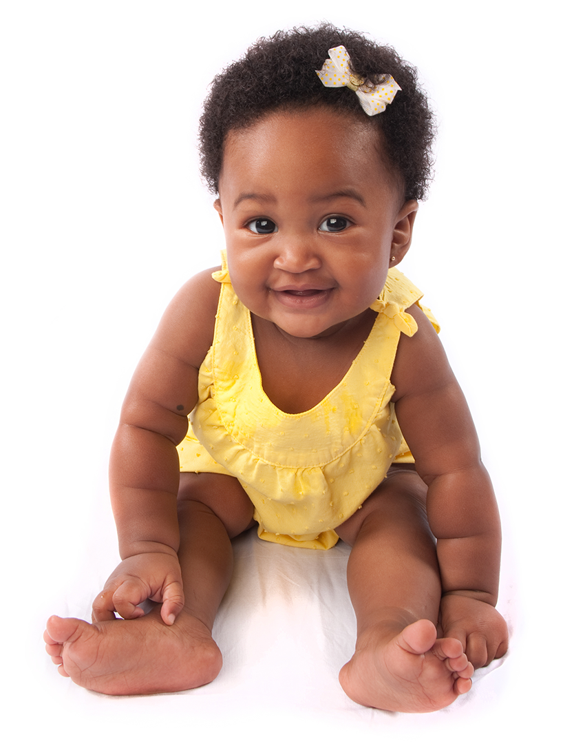
Explain to a Baby
What is a nested for loop?
Notes:
shutterstock_35376577

Slide 16
What Will This Code Do?
 | A | B | C
1 | Michael | Luis | Jin Yong
2 | Evan | Mariah | Ricky
3 | Jamie | Ron | Mateo
4 | John | Lakshmi | Adhira
Sub QuickLoop()
For i = 1 to 4
For j = 1 to 3
MsgBox(Cells(i, j))
Next j
Next i
End Sub

Slide 17
What Will This Code Do?
When:
i = 1 j = 1
 | A | B | C
1 | Michael i = 1 j = 1 | Luis | Jin Yong
2 | Evan | Mariah | Ricky
3 | Jamie | Ron | Mateo
4 | John | Lakshmi | Adhira
Sub QuickLoop()
For i = 1 to 4
For j = 1 to 3
MsgBox(Cells(i, j))
Next j
Next i
End Sub

Slide 18

What Will This Code Do?
When:
i = 1 j = 2
 | A | B | C
1 | Michael i = 1 | Luis j = 2 | Jin Yong
2 | Evan | Mariah | Ricky
3 | Jamie | Ron | Mateo
4 | John | Lakshmi | Adhira
Sub QuickLoop()
For i = 1 to 4
For j = 1 to 3
MsgBox(Cells(i, j))
Next j
Next i
End Sub

Slide 19

What Will This Code Do?
When:
i = 1 j = 3
 | A | B | C
1 | Michael i = 1 | Luis | Jin Yong j = 3
2 | Evan | Mariah | Ricky
3 | Jamie | Ron | Mateo
4 | John | Lakshmi | Adhira
Sub QuickLoop()
For i = 1 to 4
For j = 1 to 3
MsgBox(Cells(i, j))
Next j
Next i
End Sub

Slide 20
What Will This Code Do?
When:
i = 2 j = 1
 | A | B | C
1 | Michael | Luis | Jin Yong
2 | Evan i = 2 j = 1 | Mariah | Ricky
3 | Jamie | Ron | Mateo
4 | John | Lakshmi | Adhira
Sub QuickLoop()
For i = 1 to 4
For j = 1 to 3
MsgBox(Cells(i, j))
Next j
Next i
End Sub

Slide 21

What Will This Code Do?
When:
i = 2 j = 2
 | A | B | C
1 | Michael | Luis | Jin Yong
2 | Evan i = 2 | Mariah j = 2 | Ricky
3 | Jamie | Ron | Mateo
4 | John | Lakshmi | Adhira
Sub QuickLoop()
For i = 1 to 4
For j = 1 to 3
MsgBox(Cells(i, j))
Next j
Next i
End Sub

Slide 22

What Will This Code Do?
When:
i = 2 j = 3
 | A | B | C
1 | Michael | Luis | Jin Yong
2 | Evan i = 2 | Mariah | Ricky j = 3
3 | Jamie | Ron | Mateo
4 | John | Lakshmi | Adhira
Sub QuickLoop()
For i = 1 to 4
For j = 1 to 3
MsgBox(Cells(i, j))
Next j
Next i
End Sub

Slide 23
What Will This Code Do?
When:
i = 3 j = 1
 | A | B | C
1 | Michael | Luis | Jin Yong
2 | Evan | Mariah | Ricky
3 | Jamie i = 3 j = 1 | Ron | Mateo
4 | John | Lakshmi | Adhira
Sub QuickLoop()
For i = 1 to 4
For j = 1 to 3
MsgBox(Cells(i, j))
Next j
Next i
End Sub

Slide 24
Questions?

